Slide 1
Heuristic Search
Week 10

Slide 2
Contents
Classes of Problems
Search problems
Heuristics
Fitness
Global and local optima
Representation
The Travel Salesman Problem

Slide 3
Classes of Problems
Problems can be solved in polynomial time
Polynomial time is the number of steps required to complete the algorithm
P problem is polynomial time problem where a problem is called tractable
NP problem (which stands for non-deterministic polynomial time) is the set of problems whose solutions can be verified in polynomial time

Slide 4
Problems which can
be solved in polynomial
time using a “magic box”
(Non-deterministic)
NP
P
Problems which
can be solved in
polynomial time

Slide 5
If a polynomial time algorithm is found for any problem in
NP-Complete then every problem in NP can be solved in polynomial time
I.e. P = NP
NP
P
NP-Complete
The “hardest”
problems in NP

Slide 6
Heuristic Search
Some problems (NP-Hard) cannot be solved in a straight forward manner
We need to develop approximation algorithms to solve these problems
A type of method called Heuristic Search can be used to try and find a solution
We search for the best solution from a very large number of potential solutions
We score the worth of each solution using a Fitness Function
There is a theorem in heuristic search called the No Free Lunch Theorem!

Slide 7
Heuristic Search
A heuristic is a “rule of thumb” or some loose set of guidelines
Getting out of a maze by keeping your hand against the maze wall
In Artificial Intelligence these are used to improve the performance of methods, in our case, search methods
Expert knowledge
Common sense

Slide 8
Search Problems
Many problems can be thought of as searching through candidate solutions to find one that is optimal
Systematically search through potential solutions without considering all of them…
Need some way to evaluate the fitness of the candidate solutions
Optimal = fittest
Some sense of the adjacency (similarity) of solutions (or neighbourhood)

Slide 9
Fitness
The fitness of a solution that measurable.
Examples:
A good car is defined the least number of breakdowns in 2 years. Fitness = number of breakdowns in 2 years (minimise).
A bullet train. Fitness = Maximum speed (km/h)
A good singer. Fitness = can sing songs that more than 3 genres.
The Travel Salesperson Problem. Fitness = A route with the minimum distance! (minimise)

Slide 10
Fitness
In order to search for a solution, we must be able to compare potential solutions
E.g. Is solution s₁ better than solution s₂?
Thus we have the concept of fitness
We must derive a function (the fitness function) that maps a solution to a value that rates how good the solution solves the problem in hand
We either try and maximise or minimise the fitness
A slight change in solution quality should result in a corresponding change in the fitness
Solution quality goes down → Fitness goes down
Solution quality goes up → Fitness goes up

Slide 11
Fitness Landscape
It can be helpful to think of searching a landscape of solutions where:
The x and y co-ordinates represent a particular solution
Altitude (z axis) represents the fitness of that solution
This leads to the analogy that we wish to search for or climb peaks
Describing the nature of a landscape characterises (in an abstract way) classes of problem

Slide 12
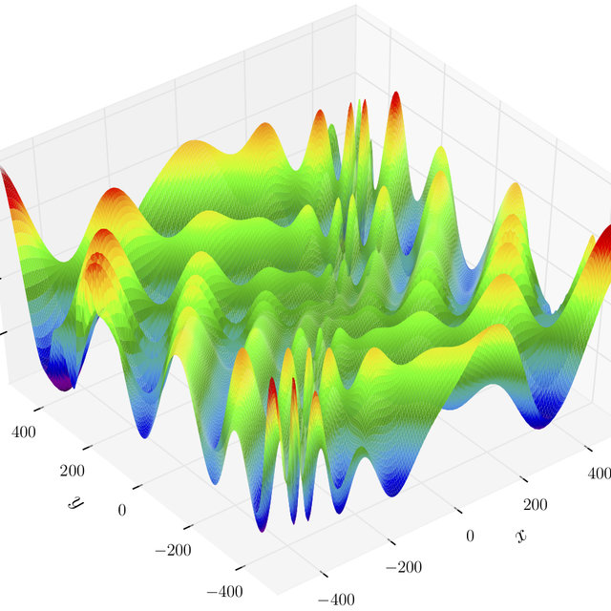
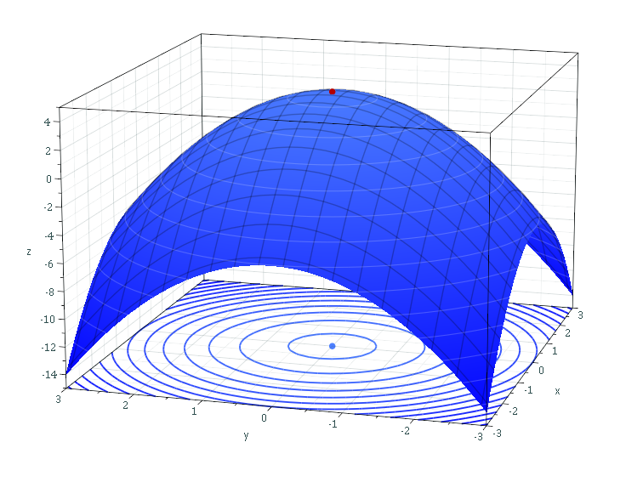
Fitness Landscape
Smooth and regular spaces are easy to search
Irregular spaces are difficult to search

Slide 13
Global and local optima
The global optimum is the point or points in the search space with the best objective function evaluation
A local optimum is the point or points in a subset or section of the search space with the best objective function evaluation
Note that the subset or section of the search space in question may contain the global optima
Many search techniques can find local optima, but get “stuck” at them and cannot move on to find the global optima

Slide 14
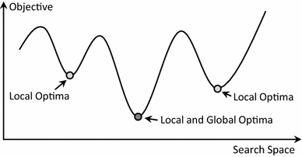
Global and local optima - Minimisation

Slide 15
Representation
When we are trying to solve a search-based problem, we need a way to represent a potential solution
This is usually a mathematical and/or data structure-based way of describing the solution to a problem
A good representation:
Should be a one-to-one mapping
No redundancy
No ambiguities
All potential solutions should be represented

Slide 16
The Travel Salesman Problem
The Travelling Salesman Problem is well known to be NP-Hard
This means there is no direct algorithmic or mathematical way to derive a solution in polynomial time
The search space (as we will see later) is O(N!)
One of the worst that we have seen to date…
We need approximate or Heuristic search methods to find a solution (or partial solution)
Genetic Algorithm
Hill Climbing
Simulated Annealing
Etc...

Slide 17
The Travel Salesman Problem
A sales person has to visit N cities as part of their job
The aim is to start off at one of the cities, visit each city exactly once and then to arrive back at the starting city
This is called a tour
The objective is to find a tour where the sum of the total distance travelled is a minimum

Slide 18
The Travel Salesman Problem
In order to solve the TSP we need to know how “far” each city is from each other
We will use the notation d(i,j) to represent the distance from city i to city j
Note:
d(i,j)=d(j,i), i.e. the distance from city i to city j is the same as from city j to city i
d(i,i) = 0, i.e.: a city is zero distance from itself
1
4
3
5
3
2
2
1.5
2.5
4
d(1,2)=3
d(1,3)=4
d(1,4)=5
d(2,3)=2
d(2,4)=2.5
d(3,4)=1.5

Slide 19
TSP Representation
A natural way to represent a solution to the TSP problem is to represent a tour as a permutation of the integers 1,2,...,N
Starting at the left-hand side of the permutation and visiting the cities in the specified order, moving from left to right
This will ensure that we do not visit any city twice
A permutation is defined as a shuffling of a set of objects
A permutation of A,B,C,D is B,C,A,D
A permutation of 1,2,3,4 is 4,1,2,3
If we have N objects then there are N! possible permutations

Slide 20
Other Paradigm Problems
Bin Packing - https://youtu.be/vUxhAmfXs2o
Scales Problem - https://youtu.be/-n-A5qcO398

